Slide 1

Corporate Electronic Registration Tool
https://corporate.goodlifefitness.com

Slide 2
First Time Member
Follow this flow if you have Never been a member of Goodlife fitness in the past

Slide 3
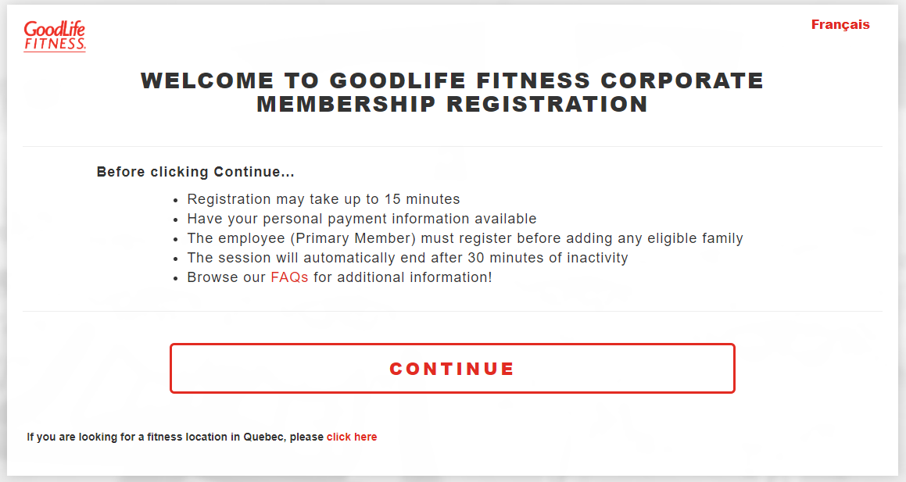
Welcome Page
Select Continue to proceed to Sign up for locations throughout Canada, except Quebec
If planning to work out in Quebec, select “click here”

Slide 4
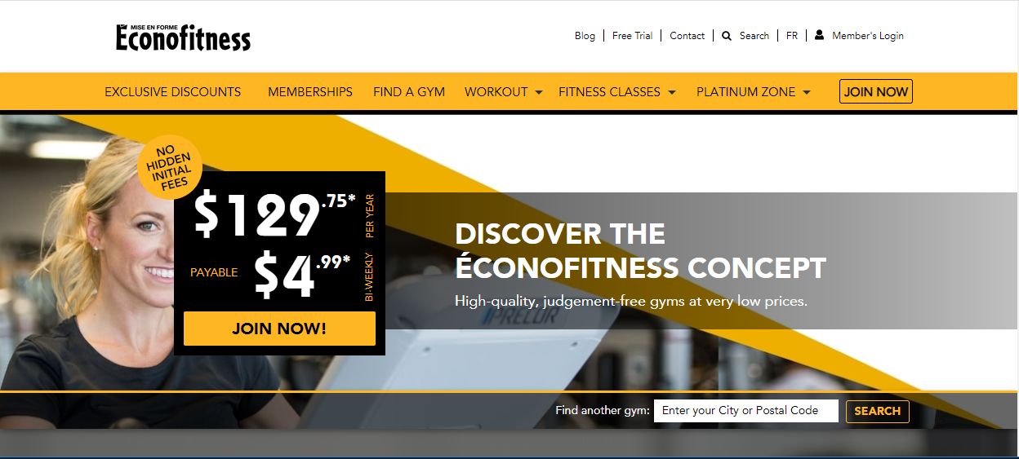
Quebec Locations Only
To purchase a membership with Econofitness in Quebec, please visit one of their club locations

Slide 5
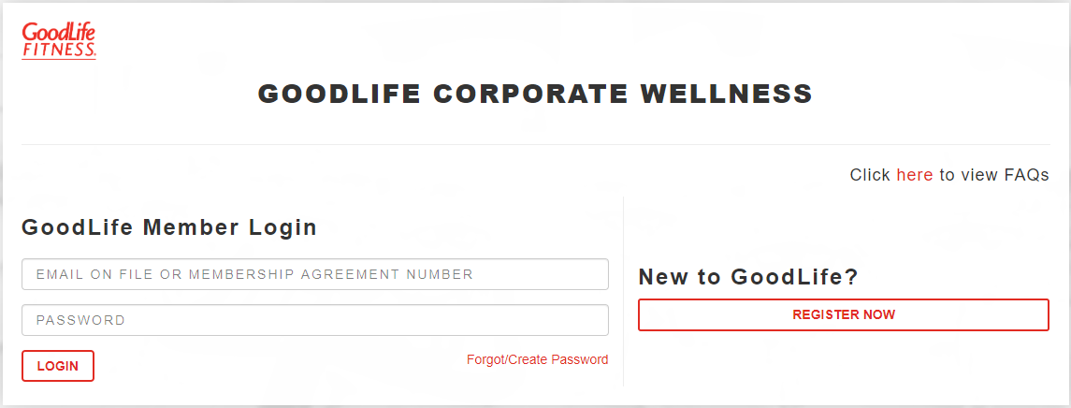
Create Account
Select “Register Now”

Slide 6
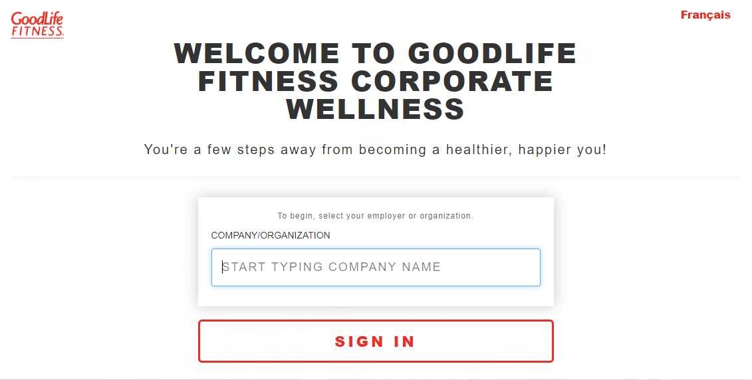
Company Search
Search for your company name
You will be prompted to confirm your employment either by entering a company identifier (unique ID) or your work email address. Follow the instructions on screen.

Slide 7
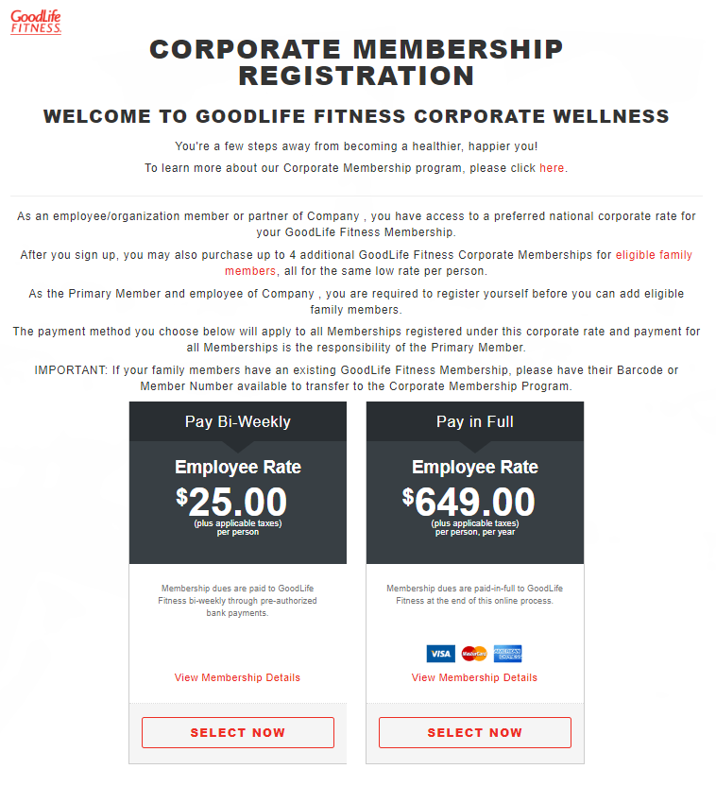
Pre-Registration Page
Select your preferred membership option

Slide 8
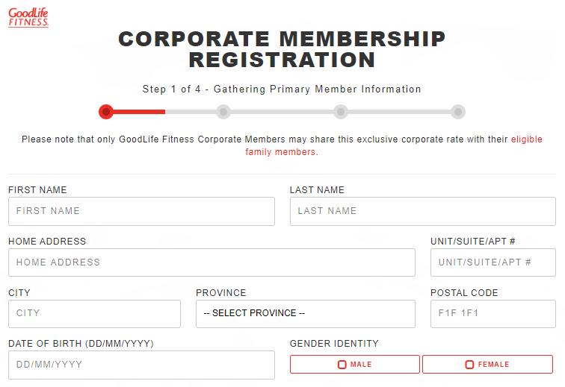
Registration Page
Complete all fields on the screen to create your account

Slide 9
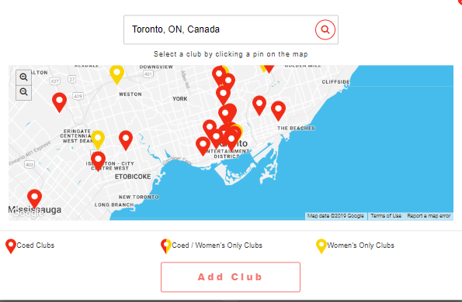
Club Selector
Click on “Select a Club” and search for the club most convenient for you

Slide 10
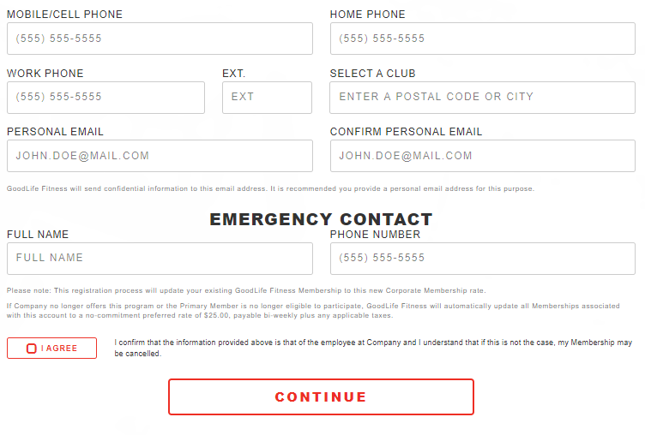
Registration Page
Please provide a personal email address
Once all fields are completed, select “I Agree” then click on “Continue”

Slide 11
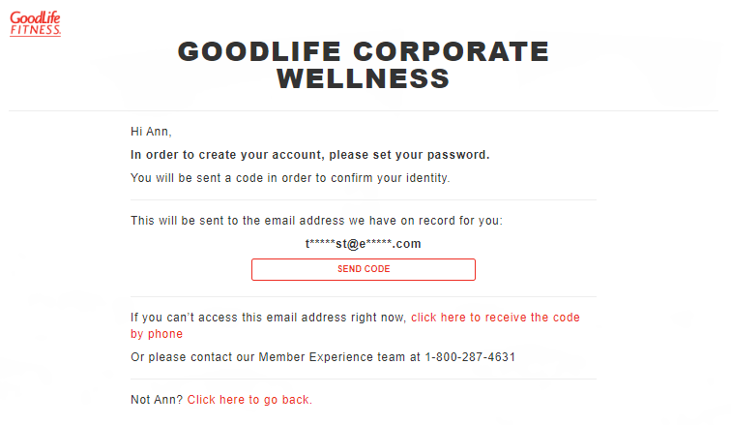
Validate Contact Information
Click on “Send Code” to send a code to your email address. This will confirm your contact information
You can also receive the code by phone

Slide 12
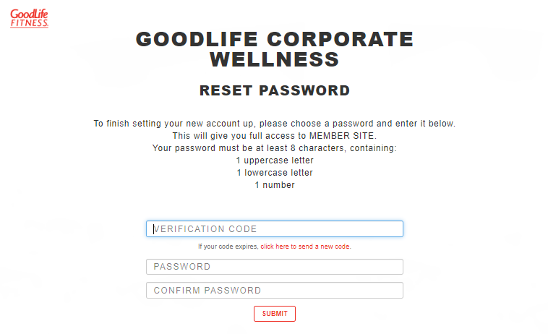
Reset Password
Enter the 6-digit code received by either email or phone, then select a new password
You can also receive the code by phone

Slide 13
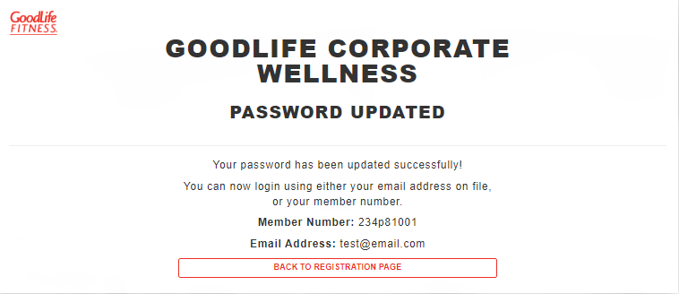
Password Confirmation
When your password is successfully updated, head back to the Registration Page to complete the membership purchase

Slide 14
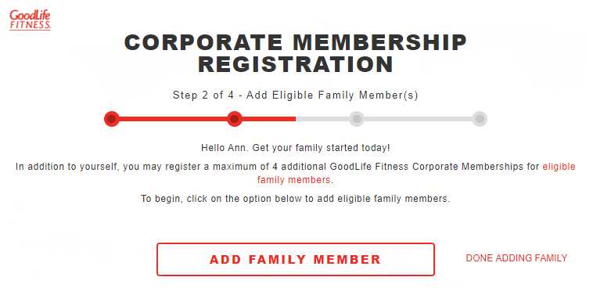
Add Family Members
To add family members to your membership, select “Add Family Member”
If you are not adding family members at this time, select “Done Adding Family”

Slide 15
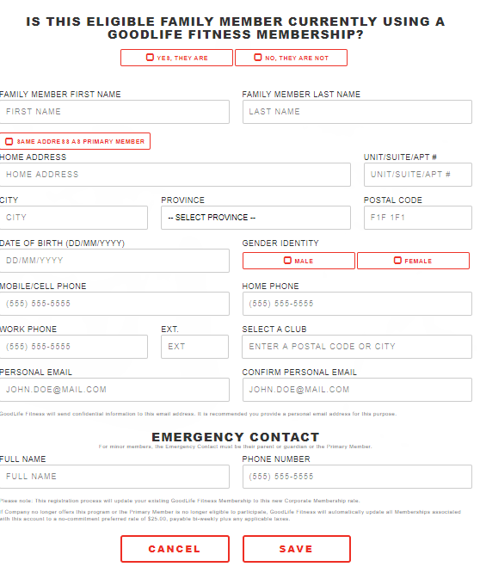
Add Family Members
Be sure to indicate whether your family member has a GoodLife membership and enter their barcode number
Fill out the registration page with your family member’s information and select “Save”

Slide 16
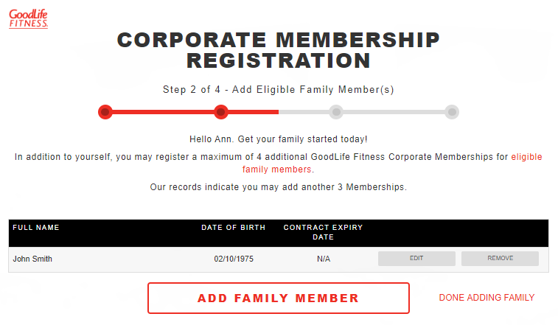
Family Summary
Add additional family members or select “Done Adding Family”

Slide 17
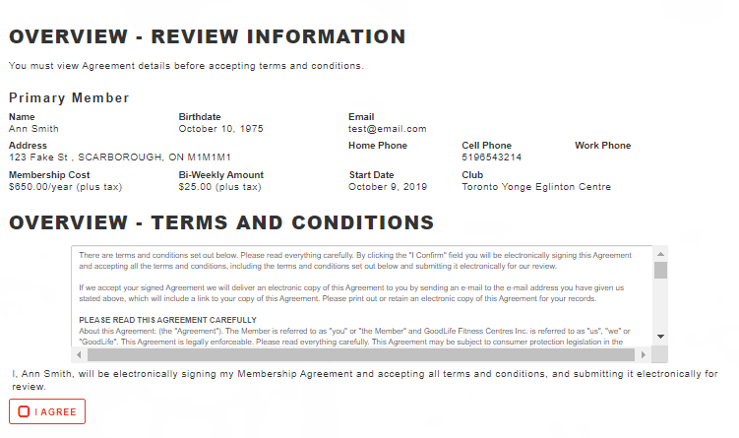
Terms and Conditions
Review the terms and conditions for your new membership, then select “I Agree”

Slide 18
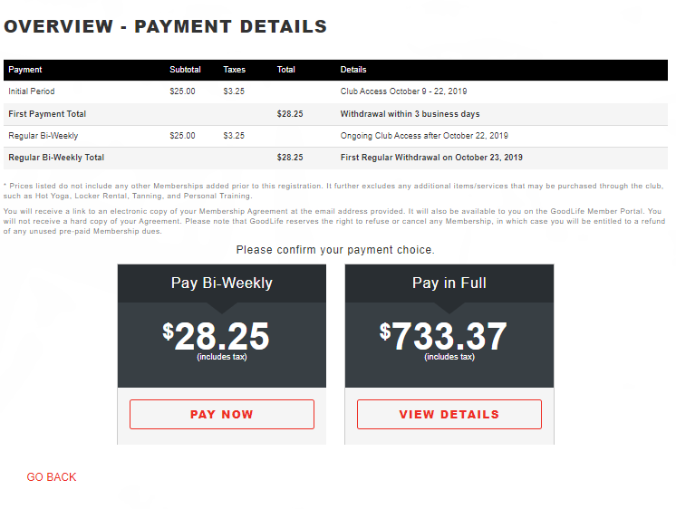
Review Information
Review your payment details to ensure they are correct and finalize your payment type

Slide 19
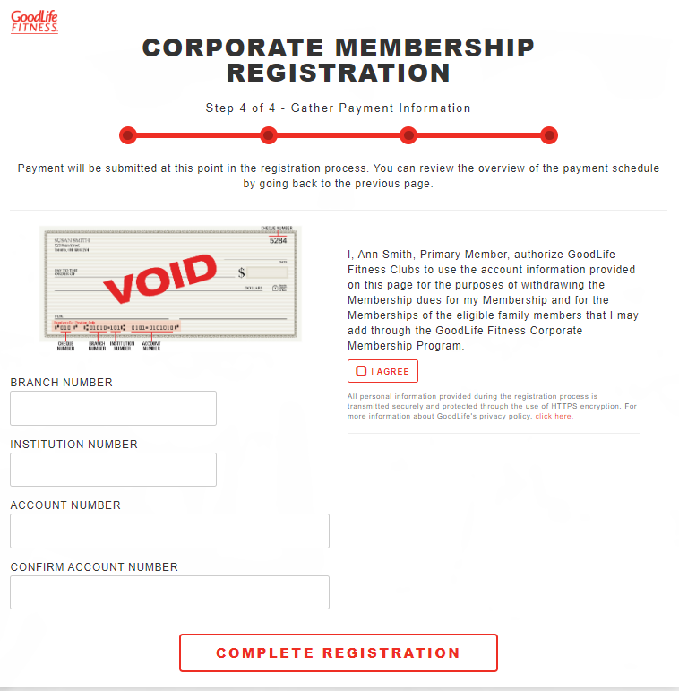
Payment Information
(Pre-authorized payments)
If you have selected the pre-authorized payment option, fill out your banking information and select “Complete Registration”
Please ensure you select “I Agree”
Please note: Credit cards are not accepted for the pre-authorized payment option

Slide 20
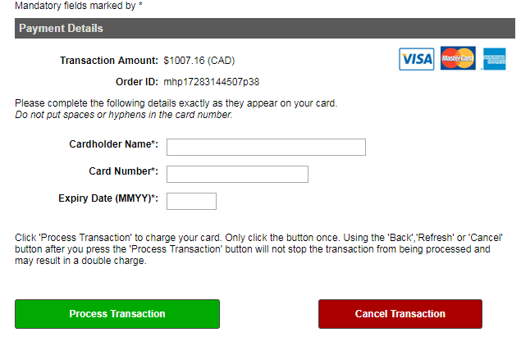
Payment Information
(Paid in Full)
If you have selected the paid in full option, you will be redirected to the Moneris site to complete your credit card payment securely

Slide 21
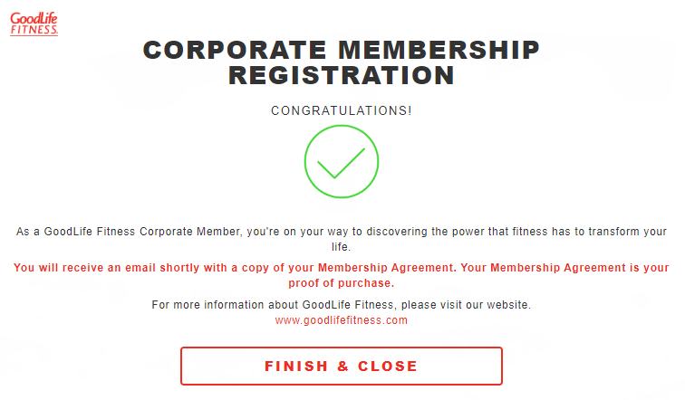
Confirmation Page

Slide 22
Returning Member
Follow this flow if you have EVER HAD A GOODLIFE FITNESS MEMBERSHIP

Slide 23

Log In
If you know your username/password, enter it and select “Login”
If you haven’t logged in since October 2019, select “Forgot/Create Password”

Slide 24
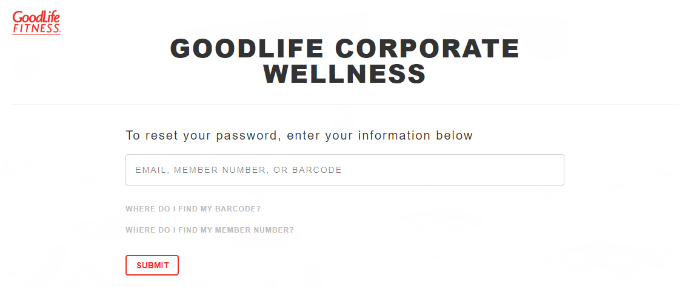
Forgot/Create Password
Enter your email address, member number (located on your contract) or your barcode

Slide 25
Validate Contact Information
Click on “Send Code” to send a code to your email address. This will confirm your contact information
You can also receive the code by phone

Slide 26
Reset Password
Enter the 6-digit code received by either email or phone, then select a new password
You can also receive the code by phone

Slide 27
Password Confirmation

Slide 28
Company Search
Search for your company name
You will be prompted to confirm your employment either by entering a company identifier (unique ID) or your work email address. Follow the instructions on screen.

Slide 29
Pre-Registration Page
Select your preferred membership option

Slide 30
Registration Page
Complete all fields on the screen to create your account

Slide 31
Club Selector
Click on “Select a Club” and search for the club most convenient for you

Slide 32
Registration Page
Please provide a personal email address
Once all fields are completed, select “I Agree” then click on “Continue”

Slide 33
Add Family Members
To add family members to your membership, select “Add Family Member”
If you are not adding family members at this time, select “Done Adding Family”

Slide 34
Add Family Members
Be sure to indicate whether your family member has a GoodLife membership and enter their barcode number
Fill out the registration page with your family member’s information and select “Save”

Slide 35
Family Summary
Add additional family members or select “Done Adding Family”

Slide 36
Terms and Conditions
Review the terms and conditions for your new membership, then select “I Agree”

Slide 37
Review Information
Review your payment details to ensure they are correct and finalize your payment type

Slide 38
Payment Information
(Pre-authorized payments)
If you have selected the pre-authorized payment option, fill out your banking information and select “Complete Registration”
Please ensure you select “I Agree”
Please note: Credit cards are not accepted for the pre-authorized payment option

Slide 39
Payment Information
(Paid in Full)
If you have selected the paid in full option, you will be redirected to the Moneris site to complete your credit card payment securely

Slide 40
Confirmation Page

